Slide 1
SAP NetWeaver on Azure Whiteboard Design Session (Trainer Deck)
Trainer names
Notes:
Welcome to the SAP NetWeaver on Azure Whiteboard Design Session

Slide 2
Abstract and learning objectives
Abstract :
In this workshop, you will look at what is involved in deploying SAP and SQL Server on Azure with the goals of designing for business continuity and flexibility as well as fully optimized total cost of ownership. At the end of this workshop, you will be able to better design, price and present SAP on Azure solutions to your customers.
Learning objectives :
Design SAP and SQL Server workloads on Azure in alignment with SAP certification with high availability and disaster recovery.
Run Azure Pricing Calculator to price the SAP landscape.
Present the solution to business/technical decision makers and handle Q&A with customer.
Prerequisite :
R-AIT344 : Architecture deep dive for SAP deployments
R-AIT333 : SAP Migration Practitioner Panel
Understanding of SAP on Azure Webinar Training and NetWeaver on Azure reference architecture
Notes:
Present the abstract, learning objectives, and prerequisites

Slide 3
Step 1: Review the customer case study
Outcome
Analyze your customer needs
Timeframe
10 minutes
Notes:
Inform students about the purpose of the first step of the design session

Slide 4
Customer situation : Contoso Group
Contoso Group is a US-based telecommunications company with headquarters in NY.
Contoso Group maintains on-premises deployments of SAP Business Suite on Windows Server 2008 R2 with a SQL Server 2008 R2 in its US-based data center.
Contoso Leadership and Planning Groups wants to drastically reduce server and storage hardware in their own datacenters to minimize IT related costs. Contoso has already a number of their non-SAP systems migrated to Azure. The leadership asked Contoso IT to look into the possibility to migrate its existing SAP Business Suite to cloud.
Contoso IT decided to leverage its knowledge of the Microsoft cloud platform and existing ExpressRoute connectivity and host its SAP landscape in Azure.
Considering that Contoso finance and supply chain team will strongly rely on SAP Business Suite, the systems should be highly available and their performance must be predictable and consistent. In addition, the management team wants to leverage disaster recovery capabilities offered by Azure in order to ensure resiliency in case the primary region hosting the new deployment becomes unavailable.
Before migrating the production environment, Contoso wants to test its new deployment approach by provisioning development, and UAT environments in Azure.
Notes:
Contoso Group is a US-based telecommunications company with headquarters in NY.
Contoso Group maintains on-premises deployments of SAP Business Suite on Windows Server 2008 R2 with a SQL Server 2008 R2 in its US-based data center.
Contoso Leadership and Planning Groups wants to drastically reduce server and storage hardware in their own datacenters to minimize IT related costs. Contoso has already a number of their non-SAP systems migrated to Azure. The leadership asked Contoso IT to look into the possibility to migrate its existing SAP Business Suite to cloud.
Contoso IT decided to leverage its knowledge of the Microsoft cloud platform and existing ExpressRoute connectivity to host its SAP landscape in Azure.
Considering that Contoso finance and supply chain teams strongly rely on SAP Business Suite, the systems should be highly available and their performance must be predictable and consistent. In addition, the management team wants to leverage disaster recovery capabilities offered by Azure in order to ensure resiliency in case the primary region hosting the new deployment becomes unavailable.
Before migrating the production environment, Contoso wants to test its new deployment approach by provisioning development, and UAT environments in Azure.

Slide 5
Contoso CIO Vision
“Our existing on-premises SAP development and test environments no longer meet the agility required by the fast pace of changes in our business. In addition, our operational dependencies on SAP applications force us to seek reasonably priced availability and disaster recovery capabilities for our production SAP deployments.”
Andrew Cross, CIO, Contoso Group
Notes:
The CIO, Andrew Cross stated “Our existing on-premises SAP development and test environments no longer meet the agility required by the fast pace of changes in our business. In addition, our operational dependencies on SAP applications force us to seek reasonably priced availability and disaster recovery capabilities for our production SAP deployments.”

Slide 6





Contoso SAP Environment
(*) SAPS : SAP Application Performance Standard (SAPS) is a hardware-independent unit of measurement that describes the performance of a system configuration in the SAP environment. It is derived from the Sales and Distribution (SD) benchmark, where 100 SAPS is defined as 2,000 fully business processed order line items per hour.
Customer Corporate Network
SAP : SAP ERP/ECC 6.0
OS : Windows Server 2008 R2
DB : SQL Server 2008 R2
Production APP server : 8 cores, 32GB RAM x 3 nodes
Production DB server : 8 cores, 32GB RAM x 1 node
Application tier SAPS : 30,000 SAPS
Database tier SAPS : 15,000 SAPS
IOPS (Production DB data files) : 20,000 IOPS
Production DB size : 750GB with max growth to 1TB
SLA : Availability 99.9%, RPO=15min, RTO = 2hr
Non-Production
Production
Migration
Compute/storage sizing ?
High Availability and DR ?
Cloud migration ?
Notes:
Contoso Group has an existing on-premises deployment of SAP ECC (SAP ERP Central Component) 6.0 on Windows Server 2008 R2 with a SQL Server 2008 R2 database in its US-based data center near New York City. The deployment consists of the development, test, quality assurance, and production systems.
The production app tier consists of three physical servers, each with 8 CPU cores and 32GB RAM. The production database tier is hosted on a single physical server with the same hardware configuration. The average performance of the application tier and the database tier is about 30,000 SAPS and 15,000 SAPS, respectively. The production SAP database workload generates about 20,000 IOPS. The current production DB size is 750GB. According to the estimates of the Contoso SAP team, the database is bound to grow to about 1TB in the next few years. In case of a disaster affecting the production instance, the business expects the RPO and RTO of 15 minutes and 2 hours, respectively.

Slide 7
Customer objections
If I have already paid for my hardware to host my dev/test environment, how am I getting any cost savings by moving it to Azure? How much more is your cloud solution costing me?
What if I need my cloud resources to access on-premises resources?
Will Azure meet our security and compliance requirements?
Do I have to pay for resources when they are stopped?
For my dev environment, can I automate stopping VMs during idle times?
Notes:
Customer raised some concerns and objections:
If I have already paid for my hardware to host my dev/test environment, how am I getting any cost savings by moving it to Azure? How much more is your cloud solution costing me?
What if I need my cloud resources to access on-premises resources?
Will Azure meet our security and compliance requirements?
Do I have to pay for resources when they are stopped?
For my dev environment, can I automate stopping VMs during idle times?

Slide 8
Discuss key design concepts (15 minutes)
Notes:
Present the key design concepts applicable to this design session

Slide 9

SAP on Azure – A wide variety on Compute instances
NetWeaver Certified
NetWeaver certified and HANA certified soon
NetWeaver and
HANA certified
NetWeaver Certified and HANA certified
SAP HANA certified
A
D
F
G
Ev3
M
A
Av2
Dv2
Dv3
G
General purpose
workloads
Compute intensive
workloads
Memory optimized for Dev/Test & PoC HANA workloads
Memory optimized for Dev/Test & PoC HANA workloads
Optimized for large production SAP HANA workloads
Purpose built instance for largest SAP HANA production workloads
HIGHEST VALUE
LARGEST SCALE-UP
vCPUs
 |  |  | 2 – 64 | 2 – 64 |  | 32 – 208 (416 in roadmap) | 96 - 768
 |  |  | 8 - 256 | 16 - 432 |  | 192 – 5700 (11.40 TiB in roadmap) | 768 – 24576
 |  |  | 69,680 | 70,050 |  | 259,950 (500k in roadmap) | 786,100
RAM (GiB)
Max SAPS
Notes:
When implementing SAP HANA-based workloads in Azure, you have the choice of deploying HANA on Azure virtual machines or bare-metal, purpose-built hardware referred to as SAP HANA on Azure (Large Instances).
There is a growing number of Azure VM SKUs certified for hosting SAP HANA including GS5 and a number of M family VM sizes (with M208ms_v2, featuring 5.7 TiB of memory and with M128s supporting scale-out configuration). There is also much larger selection of Azure VM SKUs that support non-HANA workloads (NetWeaver and non-NetWeaver products).
SAP HANA on Azure (Large Instances) involves deploying and running SAP HANA without the use of a hypervisor, with each physical server dedicated to an individual customers. The server hardware is part of a larger stamp that contain networking, compute, and storage infrastructure. Each stamp is associated with a tenant. A tenant is assigned to a single customer. A customer can have multiple tenants. SAP HANA on Azure (Large Instances) represents an example of HANA tailored data center integration (TDI) certified deployment methodology. Customers can choose from several server SKUs, ranging from 36 Intel CPU cores and 768 GB of memory to 480 Intel CPU cores and 24 TB (up to 120-TB in the scale-out configuration) of memory. Two different classes of hardware divide the SKUs into:
S72, S72m, S96, S144, S144m, S192, S192m, and S192xm, which are referred to as the "Type I class" of SKUs.
S384, S384m, S384xm, S384xxm, S576m, S576xm S768m, S768xm and S960m, which are referred to as the "Type II class" of SKUs.

Slide 10
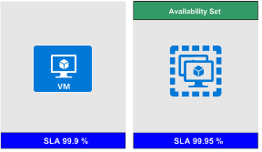
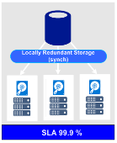
SAP VM & Storage Sizing Principles
Know # of SAPS for SAP application and database tiers
Know system activity period, use snoozing, Azure automation to shutdown (i.e. sandbox 10x5, not 24x7)
For SAP APPL servers, use a few smaller VM vs one large VM (redundant nodes).
Ensure the selected VM supports the IOPS & throughput requirements of the database server.
Choose standard or premium storage Managed Disks based on IOPS and disk throughput requirements.
Use premium storage for SAP databases (both database files and log file(s)).
For database servers use Windows storage spaces or LINUX-LVM to stripe (glue) disks and aggregate IOPS, throughput and storage capacity
SAP application servers are usually deployed on standard storage, but can be deployed on small premium storage (P4, P6) if using a single server in order to benefit from single instance SLA.
Notes:
Sizing of SAP VM compute and storage resources should be based on the following criteria:
Compute
Identify the number of SAPS for SAP application and database tiers
Identify system activity period, use snoozing and Azure automation to shutdown during idle times (i.e. run sandbox 10x5, not 24x7)
For SAP application servers, use a few smaller VM vs one large VM (to provide redundancy)
Storage
Ensure the selected VM support the IOPS & throughput requirements of the database server.
Choose Standard or Premium storage Managed Disks based on IOPS and disk throughput requirements.
Use Premium storage for SAP databases (both database files and log files).
For database servers use Windows storage spaces or LINUX-LVM to stripe (glue) disks and aggregate IOPS, throughput and storage capacity
SAP application servers are usually deployed on standard storage, but can be deployed on small premium storage (P4, P6) if using a single server in order to benefit from single instance SLA.

Slide 11
How to Size SAP Any DB (SQL Server, Oracle, DB2, ASE) on Azure VM
 | Prod or Non-Prod | SAPS required for DBMS | IOPS required for DBMS | Select a Compute SKU based on SAPS required for Database server(s) | Combine Compute SKUs based on SAPS required for SAP application servers
1 | Dev and Test | - | - | D v3, E v3 Series VM | Add D v3, E v3 Series VM – scale out as needed
2 | Production | up to 70k SAPS | Up to 128k IOPS | D v3, E v3 Series VM - scale up
3 | Production | 70k – 134k SAPS | 128k – 160k IOPS | M Series VM – scale up
4 | Production | 134k – ?? SAPS | 160k - ?? IOPS | M Series “v2” VM – scale up (* GA in CY2019)
Customer Requirements
Select Azure Compute for DBMS and Application
Notes:
How to size SAP any DB (SQL Server, Oracle, DB2, and ASE) on Azure VMs
Start by identifying customer requirements, including:
Type of environment: production, or non-production (dev and test)
SAPS required for DBMS
IOPS required for DBMS
Next, select a compute SKU based on SAPS required for database tier
Finally, combine compute SKUs based on SAPS required for application tier

Slide 12
Choose Azure VM types to meet sizing requirements
VM Series | VM Type | VM Size | Temp SSD | SAPS | # of v-disks | Max IOPS (cached) | Max Disk Bandwidth (cached) | Max Network Bandwidth | Compute (No OS) hourly on demand, USE2 | Supported HANA scenarios | Remark | SAP certification
DS v3 | D2s_v3 | 2 vCPU, 8 GiB | 16 GiB | 2,178 | 4 | 4,000 | 32 MB/sec | moderate | $ 0.110 |  | Xeon E5-2673 v4 (Broadwell) 3.5Ghz TB | Certified (Any DB, App)
 | D4s_v3 | 4 vCPU, 16 GiB | 32 GiB | 4,355 | 8 | 8,000 | 64 MB/sec | moderate | $ 0.220
 | D8s_v3 | 8 vCPU, 32 GiB | 64 GiB | 8,710 | 16 | 16,000 | 128 MB/sec | high | $ 0.440
 | D16s_v3 | 16 vCPU, 64 GiB | 128 GiB | 17,420 | 32 | 32,000 | 256 MB/sec | high | $ 0.880
 | D32s_v3 | 32 vCPU, 128 GiB | 256 GiB | 34,840 | 32 | 64,000 | 512 MB/sec | extremely high | $ 1.760
 | D64s_v3 | 64 vCPU, 256 GiB | 512 GiB | 69,680 | 32 | 128,000 | 1024 MB/sec | extremely high | $ 3.520
ES v3 | E2s_v3 | 2 vCPU, 16 GiB | 32 GiB | 2,178 | 4 | 4,000 | 32 MB/sec | 1 Gbps | $ 0.146 |  | Xeon E5-2673 v4 (Broadwell) 3.5Ghz TB | Certified (Any DB, App)
 | E4s_v3 | 4 vCPU, 32 GiB | 64 GiB | 4,355 | 8 | 8,000 | 64 MB/sec | 2 Gbps | $ 0.293
 | E8s_v3 | 8 vCPU, 64 GiB | 128 GiB | 8,710 | 16 | 16,000 | 128 MB/sec | 4 Gbps | $ 0.585
 | E16s_v3 | 16 vCPU, 128 GiB | 256 GiB | 17,420 | 32 | 32,000 | 256 MB/sec | 8 Gbps | $ 1.170 |  | Xeon E5-2673 v4 (Broadwell) 3.5Ghz TB | HANA certification in roadmap App, Any DB certified
 | E32s_v3 | 32 vCPU, 256 GiB | 512 GiB | 34,840 | 32 | 64,000 | 512 MB/sec | 16 Gbps | $ 2.341 | OLTP/OLAP
 | E64s_v3 | 64 vCPU, 432 GiB | 864 GiB | 70,050 | 32 | 128,000 | 1024 MB/sec | 30 Gbps | $ 4.412 | OLTP/OLAP
M | M32ts | 32 vCPU, 192 GiB | 1,000 GiB | 33,670 | 16 | 40,000 | 400 MB/sec | 8 Gbps | $ 2.707 | OLTP | Intel® Xeon® E7-8890 v3 (Haswell) | HANA, App, Any DB certified
 | M32ls | 32 vCPU, 256 GiB | 1,000 GiB | 33,300 | 16 | 40,000 | 400 MB/sec | 8 Gbps | $ 2.873 | OLTP
 | M64ls | 64 vCPU, 512 GiB | 2,000 GiB | 66,600 | 32 | 80,000 | 800 MB/sec | 16 Gbps | $ 5.415 | OLTP
 | M64s | 64 vCPU, 1,024 GiB | 2,000 GiB | 67,315 | 32 | 80,000 | 800 MB/sec | 16 Gbps | $ 6.669 | OLTP/OLAP
 | M64ms | 64 vCPU, 1,792 GiB | 2,000 GiB | 68,930 | 32 | 80,000 | 800 MB/sec | 16 Gbps | $ 10.337 | OLTP
 | M128s | 128 vCPU, 2,048 GiB | 4,000 GiB | 134,630 | 64 | 160,000 | 1,600 MB/sec | 30 Gbps | $ 13.338 | OLTP/OLAP
 | M128ms | 128 vCPU, 3,800 GiB | 4,000 GiB | 134,630 | 64 | 160,000 | 1,600 MB/sec | 30 Gbps | $ 26.688 | OLTP
M v2 | M208s v2 | 208 vCPU, 2,850 GiB | 7,040 GiB | 259,950 | 64 | 80,000 | 1.000 MB/sec | 16 Gbps | $ 22.31 | OLTP/OLAP | Intel® Xeon® Platinum 8180M 2.5GHz (Skylake) | HANA, App, Any DB certified
 | M208ms v2 | 208 vCPU, 5,700 GiB | 7,040 GiB | 259,950 | 64 | 80,000 | 1,000 MB/sec | 16 Gbps | $ 44.62 | OLTP/OLAP
SAP Note 1928533 and https://docs.microsoft.com/en-us/azure/virtual-machines/windows/sizes-memory
Notes:
Review performance characteristics referenced in the table on the current slide. Point out that some of the VM types are on the certification roadmap for SAP HANA. Explain that, in order to implement SAP workloads on Azure in a supported manner, customers should following SAP certified configurations, which consist of a combination of the following four elements:
- SAP product
- Operating system
- RDBMS
- Azure offering, including Azure VM SKU and (in case of HANA) SAP HANA on Azure (Large Instances)
For additional information, refer to SAP Note #1928533 - SAP Applications on Azure: Supported Products and Azure VM types

Slide 13

Premium Storage KPIs (Cost differ by region)
Premium Storage Disk Type | P4 | P6 | P10 | P15 | P20 | P30 | P40 | P50
Disk size | 32 GB | 64 GB | 128 GB | 256 GB | 512 GB | 1024 GB (1 TB) | 2048 GB (2 TB) | 4096 GB (4 TB)
IOPS per disk | 120 | 240 | 500 | 1100 | 2,300 | 5,000 | 7,500 | 7,500
Throughput per disk | 25 MB/s | 50 MB/s | 100 MB/s | 125 MB/s | 150 MB/s | 200 MB/s | 250 MB/s | 250 MB/s
Consistent low latency SSD with predictable throughput
For high-performance IO-intensive DB workloads
Single digit ms latencies
Supports up to 32 TB blob/disk size
Stripe up to 64 disks for a total of 2,048 TB
Disk performance is dependent on the disk size, with up to 7,500 IOPS per disk
Pay for what you provision
Check Azure VMs for maximum IOPS
* Stripe Premium Storage Disks to aggregate
IOPS, Throughput and Storage Capacity
Notes:
Consistent low latency SSD with predictable throughput
Intended for high-performance IO-intensive DB workloads
Single digit ms latencies
Supports up to 32 TB blob/disk size
Stripe (to aggregate IOPS, throughput, and capacity) up to 64 disks for a total of 2,048 TB
Disk performance is dependent on the disk size, with up to 20,000 IOPS per disk
Ensure to account for Azure VMs level IOPS limits
Pay for what you provision (cost per GB differs by region)

Slide 14


SAP HA in Availability Set and DR across Regions
Primary Azure Region
Secondary Azure Region
AvSet
AvSet
SQL Server Database layer (=SPOF)
SQL AlwaysOn on Windows Failover Cluster
SQL Server AlwaysOn (Async)
AvSet
Blob storage for ASR
AvSet
SAP Central Services (ASCS) layer on Windows (=SPOF)
ASCS on Windows Failover Cluster
ASR Replication
ASCS on Windows Failover Cluster
AvSet
AvSet
SAP file share layer on Windows (=SPOF)
SOFS on Windows Failover Cluster
ASR Replication
SOFS on Windows Failover Cluster
AvSet
AvSet
SAP Application Server layer (= Non-SPOF)
SAP Logon Group
ASR Replication
SAP Logon Group
Notes:
The current slide represents the traditional design, which relies on well-established concept of availability sets and leverages a pair of Azure regions in the same geography. An Azure Availability Set is a logical grouping capability that helps ensure that the VM resources that you place within the Availability Set are failure-isolated from each other when they are deployed within an Azure datacenter. Azure ensures that the VMs you place within an Availability Set run across multiple physical servers, compute racks, storage units, and network switches. This configuration is referred to as placements in different update and fault domains. These placements usually are within an Azure datacenter. Assuming that power source and network issues would affect the datacenter that you are deploying, all your capacity in one Azure region would be affected.
Note that it is important to consider high availability and disaster recovery provisions separately for each component of this design:
- HANA Database layer - both high availability and disaster recovery is implemented by using HANA System Replication (synchronous or asynchronous, depending on the option). In case of synchronous replication, the high availability functionality relies additionally on Linux-based Pacemaker clustering.
- SAP Central Services (ASCS) layer - high availability is implemented by using operating system-level clustering (either Windows Server Failover Clustering or Linux-based Pacemaker clustering, depending on the underlying operating system). Disaster recovery relies across Azure regions on Azure Site Recovery, which replicates virtual disks of cluster members to the secondary site. Azure Site Recovery is also used to orchestrate failover between sites.
- SAP file share layer - high availability of the sapmnt share is implemented by using either Windows-based file share (based on Windows Storage Spaces Direct cluster hosting Scale-Out File Server) or Linux-based NFS mount (based on Azure NetApp Files or Linux Distributed Replicated Block Device). Disaster recovery relies on Azure Site Recovery, which replicates the file sharing infrastructure to the secondary site. When using Azure NetApp Files NFS-based approach, NetApp offers a SaaS based solution called NetApp Cloud Sync. You can use any file based-copy tool (such as rsync) to replicate data to the secondary site (including file or folder permissions).
- SAP Application Server layer - high availability is implemented by simply deploying multiple application servers. Disaster recovery across Azure regions relies on Azure Site Recovery, which replicates virtual disks of application servers to the secondary site. Azure Site Recovery is also used to orchestrate failover between sites.

Slide 15
S/4HANA HA and DR across Availability Zones
Azure Availability Zone 1 (Active)
Azure Availability Zone 2
SQL Server Database layer (=SPOF)
SQL Server AlwaysOn on Windows Failover Cluster
SAP Central Services (ASCS) layer on Windows (=SPOF)
ASCS on Windows Failover Cluster
SAP file share layer on Windows (=SPOF)
SOFS on Windows Failover Cluster
SAP Application Server layer (= Non-SPOF)
SAP Logon Group
SAP Logon Group
Notes:
The current slide represents a different design that takes advantage of availability zones, representing separate, physically isolated data centers within the same region. The placement of datacenters that represent Azure Availability Zones constitutes a compromise between delivering acceptable network latency to services deployed in different zones, and a distance between datacenters. The distance matters because even though majority of destructive events are not likely to affect the infrastructure of all Availability Zones in the same region, history offers examples of larger scale disasters that could have such impact. To account for such occurrences, organizations might have the minimum distance requirement between the location of their production and disaster recovery sites. For most Azure customers, the minimum distance definition necessitates the use of two or more Azure regions.
Note that it is important to consider high availability and disaster recovery provisions separately for each component of this design. In this case, the highly available production components are distributed across Availability Zone 1 and Availability Zone 2:
- HANA Database layer is hosted by a Linux Pacemaker cluster containing an active VM instance residing in Availability Zone 1 and standby VM instance residing in Availability Zone 2, with HANA Synchronous replication between nodes of the cluster. Clustering is implemented by using Pacemaker.
- ASCS layer hosted by a Windows cluster contains an active VM instance residing in Availability Zone 1 and a standby VM instance residing in Availability Zone 2.
- SAP file share layer on Windows cluster contains an one VM node residing in Availability Zone 1 and another VM node residing in Availability Zone 2.
- SAP Application Server layer consists of a PAS server VM in Availability Zone 1 and AAS in Availability Zone 2. Clustering is not used in this case since high availability is built-into the PAS and AAS functionality.

Slide 16
Enterprise Backup Solutions for LOB applications/SAP on Azure
Fully online backup of SQL Server databases, Files and OS states while system overhead is minimum
Backup to Azure Blob Storage (= Azure Backup Vault)
Point-in-time restore
Saving backup storage (= Incremental Backup)
Centralized console for monitoring and alert capabilities
1
2
3
4
5
Notes:
Fully online backup of SQL Server databases, Files and OS states while system overhead is minimum
Backup to Azure Blob Storage (Azure Backup Vault)
Point-in-time restore
Saving backup storage (via incremental backups)
Centralized console for monitoring and alert capabilities

Slide 17
SAP on Azure Backup Solutions
 | Standard DB backup (e.g. SQL, Oracle, HANA) |  | Azure Backup Server (=SCDPM on Azure) | 3rd party solutions (e.g. Commvault, NetBackup) | Azure IaaS VM Backup | HANA on Azure Large Instances Storage Snapshot
Backup type | Database |  | Network/Agent | Network/Agent | Snapshot | Storage level snapshot
Backup target | DBs within Azure VMs |  | SQL Server DBs, Files and OS States (Windows) within Azure VMs (link) | SQL Server/Oracle/HANA, Files and OS States (Windows, Linux) within Azure VMs | Azure VMs (Windows, Linux) running SQL Server (link) | HANA database volume, HANA log volume, boot volume (link)
Linux (Guest OS) support | - |  | No | Yes | Yes | Yes
SQL Server database backup capability | Transaction log (every minute), differential, full |  | Differential every 15 minutes and full (express) | Yes | Up to 3 times per day | -
Oracle database backup | No |  | No | Yes | File consistent backup with RMAN | -
Compression | Supported |  | Supported (storage sizing : link) | Supported | None | -
Backup servers running on | DB Server |  | Microsoft Azure Backup Server (on VM) (installation kits downloadable from Azure Portal) (VM sizing : link) | Backup Server (on VM) | None (Backup as a Service) | -
Agent software required | No |  | Agent in backup target VMs and Azure Backup Agent in Azure Backup Server VMs | Yes | No (* Only Azure VM Agent) | No
Network bandwidth required | Yes but controllable |  |  |  | None | None
Short term retention | Yes (on local storage) |  |  |  | None | Yes (on local NFS storage)
Long term retention | Possible |  |  |  |  | Up to 255 snapshots per volume (or transfer to Blob Storage)
Point-in-time recovery | Possible
Recovery speed | Depend on I/O speed of underneath Blob storage or Backup Vault |  |  |  |  | Fast
Monitoring/alerting console | Database console | Azure Backup Server Console |  | Backup Server Console | Azure Management Portal | Script
Reporting | Database console | System Center Service Manager |  | Backup Server Reporting | None | Script
Licensing | Built-in | Pay-per-use on Azure (link) |  | Check vendor | Pay-per-use on Azure (link) | Built-in
Notes:
Standard DB backup (e.g. SQL, Oracle, HANA)
Azure Backup Server or System Center Data Protection Manager (SCDPM)
Azure IaaS VM Backup
3rd party solutions (e.g. Commvault or NetBackup)
HANA on Azure Large Instances storage snapshot

Slide 18
Disaster Recovery Solutions for LOB applications/SAP on Azure
Business requirements
Minimum data loss in case of a disaster
Failover complete within hours including SAP application layer
Clear failover process
Failover transparent to users & sub systems
Minimum costs for DR
IT requirements
Production environment is on virtualization, bare metal or cloud
Minimum overhead on Production systems and network
Retire traditional SAN/Tape-based solutions
1
2
Database Replication (e.g. SQL Server AlwaysOn)
File Replication (e.g. File Copy)
VM Replication (Azure Site Recovery)
(*) Note : ASR now support replication from shared cluster disk or Win 2016 SOFS
Notes:
Requirements can be divided into two categories:
1. Business requirements:
- Minimum data loss in case of a disaster
- Failover completed within hours (including SAP application layer)
- Clear failover process
- Failover process is abstracted from users and subsystems
- Minimum cost
2. IT requirements:
- Production environment is virtualized, on bare metal, or in the cloud
- Minimum overhead on production environment (including networking)
- No need for traditional SAN/tape backup solutions
Recommended solution consist of three primary components:
- Database replication (e.g. SQL Server AlwaysOn)
- File replication (e.g. file copy)
- VM replication (Azure Site Recovery)

Slide 19
How to size SAP on Azure VM
1
Choose VM type for SAP ASCS (*) , Application and Database, based on SAPS required
2
Decide Premium Storage type and # of disks for SAP database file space, based on IOPS/throughput
3
Set up high availability solution for SAP ASCS and Database, based on SLA
Customer Requirements
(*) ASCS : ABAP SAP Central Services – part of SAP application servers running message/enqueue service, which is a single point of failure (SPOF)
Sizing for Azure
 | SAPS needed | IOPS needed | Current DB Volume | Azure VM Type | # of VMs | All Active ? | SAPS provided | Database Files Premium Storage SKU and number of disks | IOPS for Database Files provided | Storage size allocated for DB files | Database Log Premium Storage SKU and number of disks | Latency for Log
SOFS | - | - | - | D2s_v3 | 2 | Active/ Passive | -
ASCS (*) | 30,000 | - |  | ?? | ?? | Active/ Passive | ?? | -
Application |  | - |  | ?? | ?? | All Active | ?? | -
Database | 15,000 | 10,000 | 1TB | ?? | ?? | Active/ Passive | ?? | ?? | ?? | ?? | ?? | Single digit ms latency
3
2
2
1
3
1
Notes:
In general, there are two ways to determine the proper size of SAP systems to be implemented in Azure – by using reference sizing or by employing SAP Quick Sizer.
For existing on-premises systems, you should reference system configuration and resource utilization data. The system utilization information is collected by the SAP OS Collector and can be reported via transaction OS07N as well as the Early Watch Report. Similar information can be retrieved by leveraging any system performance and statistics gathering tools.
The SAP EarlyWatch Alert is a diagnostic service that delivers monitoring of both SAP and non-SAP systems in the SAP Solution Manager. The service captures variety of performance-related data, including, for example, general component status, system configuration, average response times, system load, critical error messages and process interruptions.
For new systems, you should use SAP quick sizer, which can be accessed at https://service.sap.com/quicksizer. Note that access to it requires an Online Service System account. Online Service System (or, in short, OSS) is used to provide online access to SAP users and partners to SAP applications and data
Quick Sizer offers two independent sizing approaches: user-based and throughput-based. For smaller environments, the user-based sizing approach might be sufficient. Business requirements are determined by the number of users performing business specific tasks. Users are grouped per business task according to their estimated usage activity. For larger and more complex environments, it is recommended to use throughput-based sizing. This takes into account not only the number of users performing business specific tasks but also an information about business processes and business objects.
For the purpose of this design session, you will assume that the relevant sizing data has already been collected. In order to identify the configuration of our Azure-based deployment, you will perform three tasks:
- Choose VM type of SAP ASCS, application, and database layers based on the provided SAPS values
- Choose storage type and the number of disks for SAP database layer based on the provided IOPS and throughput values
- Identify the number of VMs for SAP ASCS, application, and database layers based on the provided resiliency requirements

Slide 20

SAP Business Suite, NetWeaver – Azure VM with HA and DR
Decide Azure regions to use
1
Azure Backbone network
5
What other Azure services can be used ?
7
Azure Region
How to design highly available ASCS, SOFS and AP ?
4
How to design highly available SQL Server VMs ?
Customer Corporate Network
VPN/ ExpressRoute Gateway SKU ?
Azure Virtual Network #1
3
GW Subnet
Subnet #1 – AP Prod
Subnet #2 – DB Prod
Subnet #3 Mgmt
Non-Production
HANA Database Server(s) Prod
Azure Region
Production
Azure Virtual Network #2
GW Subnet
Subnet #4 – AP DR
Subnet #5 – DB DR
Subnet #6 Mgmt
HANA Database Server(s) Prod
ExpressRoute or/and S2S VPN ?
2
What are DR solutions ?
8
Notes:
When designing the architecture of your solution, consider the following factors:
- the choice of the Azure region(s)
- the hybrid connectivity method (ExpressRoute and/or Site to Site VPN)
- the choice of the virtual gateway SKUs
- the method of implementing high-availability of the database layer
- the method of implementing high-availability of the ASCS and application servers
- the role of Azure services in your solution
- the method of implementing disaster recovery in your solution

Slide 21
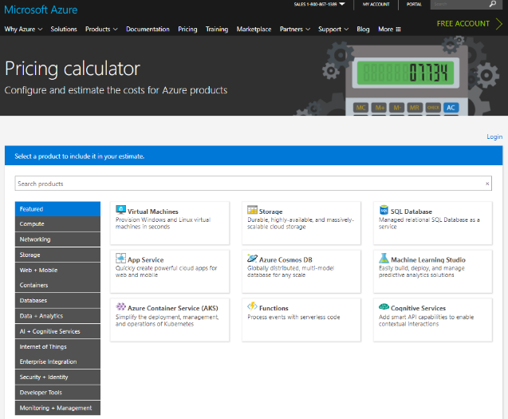
Online Azure pricing calculator
https://azure.microsoft.com/en-us/pricing/calculator/
Notes:
Demonstrate the use of Azure Pricing Calculator as you present this slide.

Slide 22
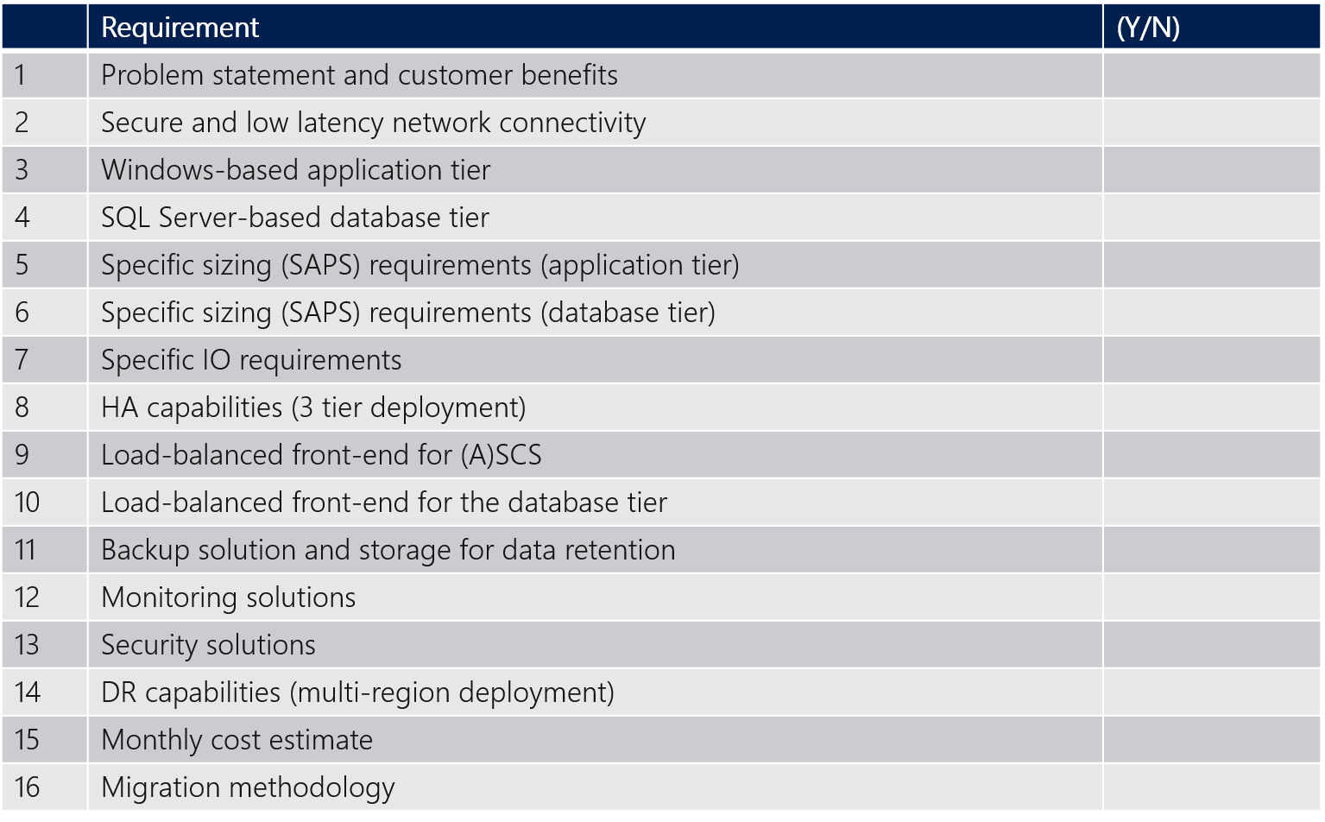
Requirements
Notes:
Use the following list of requirements when designing your solution

Slide 23
Step 2: Design and price the solution
Outcome
Design a solution and prepare to present the solution to the target customer audience in a 15-minute chalk-talk format.
Timeframe
50 minutes
Business needs (10 minutes) | Respond to questions outlined in your guide and list the answers on a flipchart
Design (30 minutes) | Design a solution for as many of the stated requirements as time allows. Show the solution on a flipchart
Prepare (10 minutes) | Identify any customer needs that are not addressed with the proposed solution Identify the benefits of your solution Determine how you will respond to the customer’s objections Prepare for a 15-minute presentation to the customer
Notes:
Inform students about the purpose of the second step of the design session

Slide 24
Step 3: Present the solution
Outcome
Present a solution to the target customer in a 15-minute chalk-talk format
Timeframe
30 minutes (15 minutes for each team to present and receive feedback)
Directions
Pair with another table
One table is the Microsoft team and the other table is the customer
The Microsoft team presents their proposed solution to the customer
The customer asks one of the objections from the list of objections in the case study
The Microsoft team responds to the objection
The customer team gives feedback to the Microsoft team
Notes:
Inform students about the purpose of the third step of the design session

Slide 25
Wrap-up
Outcome
Identify the preferred solution for the case study
Identify solutions designed by other teams
Timeframe
20 minutes
Notes:
Keep track of time and coordinate students’ activities

Slide 26
Preferred target audience
Business Development Manager (BDM) or Application Sponsor (CFO)
Funds projects and apps
Most interested in public cloud
Business Unit IT / Developers (Director of SAP Business Analysts, Director of SAP Operations)
Reports to BDM and is responsible for coding and testing apps
Big influencer of public cloud strategy
Central IT (VP of IT Operations)
Reports into CIO and responsible for operating datacenter
Concerned about shadow IT created issues: security/compliance, server sprawl, and lack of control
Notes:
The target audience should consist of:
Business Development Manager (BDM) or Application Sponsor (CFO)
Funds projects & apps
Most interested in public cloud
Business Unit IT / Developers (Director of SAP Business Analysts, Director of SAP Operations)
Reports to BDM and is responsible for coding and testing apps
Big influencer of public cloud strategy
Central IT (VP of IT Operations)
Reports into CIO and responsible for operating datacenter
Concerned about shadow IT created issues: security/compliance, server sprawl, and lack of control

Slide 27



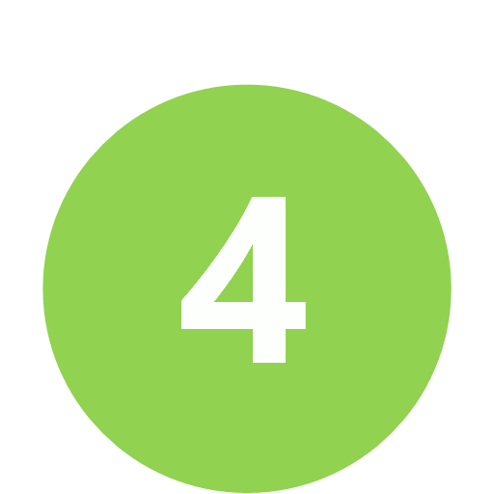


Customer Example : Current State of SAP and Benefits of Azure Migration
Current State
Contoso SAP is ECC on Windows/SQL 2008 R2 – EOS coming soon
Fixed size of hardware - underutilized /oversized
Largest server 8-core, 32GB RAM, 15K SAPS, 1TB DB
HANA infrastructure for future migration costly
Still concerned about Cloud/HANA migration
No BI/Analytics/UX solution identified
Contoso SAP is fully certified for Azure –OS/DB upgradable
Your SAP can scale any time and any way in Azure
8-core Azure VM is $0.4/hour - largest VM is 128-core, 4TB RAM, 134k SAPS
SAP certified HANA infrastructure available from 192GB to 24TB on Azure
All SAP system copy/HANA migration tools are supported on Azure
Power BI & a variety of BI/Analytics/UX solutions available in Azure
Benefits of Microsoft Cloud Platform
Notes:
It’s very important to create a slide like this / for each customer / to share your observation on customer’s current state / and to tell all the benefits of migration / to Microsoft Cloud. So the current state is / #1 Contoso SAP is ERP on SQL, / #2 hardware is fixed size,/ underutilized and oversized / largest server is DB / with 8-core, 32GB RAM and 2TB DB, / no virtualization nor BI/Analytics identified / and customer concerned about migration. And benefits of Microsoft Cloud - / #1 the SAP application and platform / that Contoso is running / are fully certified for Azure. / #2 – Contoso SAP can scale up/down/out/in / any time and any way in Azure / #3 – 8-core Azure VM is just 80 cents per hour / and largest VM is 32-core, 448GB RAM and 41k SAPS. / Customer can have / full virtualization, automation, standardization / and BI/Analytics solutions in Azure, / and #6 SAP standard SAP System Copy Tool / can be used to Cloud migration.

Slide 28
How to Size SAP Any DB (SQL Server, Oracle, DB2, ASE) on Azure VM
1
Choose VM type for SAP ASCS (*) , Application and Database, based on SAPS required
2
Decide Premium Storage type and # of disks for SAP database file space, based on IOPS/throughput
3
Set up high availability solution for SAP ASCS and Database, based on SLA
Customer Requirements
(*) ASCS : ABAP SAP Central Services – part of SAP application servers running message/enqueue service, which is a single point of failure (SPOF)
Sizing for Azure
 | SAPS needed | IOPS needed | Current DB Volume | Azure VM Type | # of VMs | All Active ? | SAPS provided | Database Files Premium Storage SKU and number of disks | IOPS for Database Files provided | Storage size allocated for DB files | Database Log Premium Storage SKU and number of disks | Latency for Log
SOFS | - | - | - | D2s_v3 | 2 | Active/ Passive | -
ASCS (*) | 30,000 | - |  | D2s_v3 | 2 | Active/ Passive | 2,178 | -
Application |  | - |  | D16s_v3 | 2 | All Active | 34,840 | -
Database | 15,000 | 10,000 | 1TB | D16s_v3 | 2 | Active/ Passive | 17,420 | 2 x P30 disks (1TB, 5000 IOPS/ disk) | 10,000 | 2TB | 1 x P20 disk (0.5TB, 2500 IOPS /disk) | Single digit ms latency
3
2
2
1
3
1
Notes:
In general, there are two ways to determine the proper size of SAP systems to be implemented in Azure – by using reference sizing or by employing SAP Quick Sizer.
For existing on-premises systems, you should reference system configuration and resource utilization data. The system utilization information is collected by the SAP OS Collector and can be reported via transaction OS07N as well as the Early Watch Report. Similar information can be retrieved by leveraging any system performance and statistics gathering tools.
The SAP EarlyWatch Alert is a diagnostic service that delivers monitoring of both SAP and non-SAP systems in the SAP Solution Manager. The service captures variety of performance-related data, including, for example, general component status, system configuration, average response times, system load, critical error messages and process interruptions.
For new systems, you should use SAP quick sizer, which can be accessed at https://service.sap.com/quicksizer. Note that access to it requires an Online Service System account. Online Service System (or, in short, OSS) is used to provide online access to SAP users and partners to SAP applications and data
Quick Sizer offers two independent sizing approaches: user-based and throughput-based. For smaller environments, the user-based sizing approach might be sufficient. Business requirements are determined by the number of users performing business specific tasks. Users are grouped per business task according to their estimated usage activity. For larger and more complex environments, it is recommended to use throughput-based sizing. This takes into account not only the number of users performing business specific tasks but also an information about business processes and business objects.

Slide 29

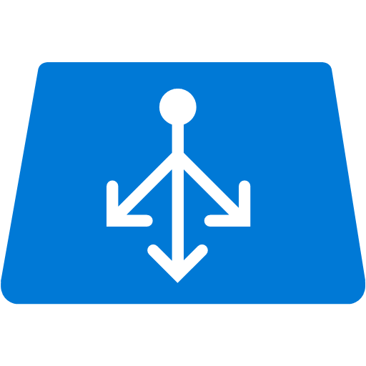













SAP Business Suite, NetWeaver – Azure VM with HA and DR
OMS Log Analytics, Backup
3
2-node x SQL Server AlwaysOn sync replica Uptime SLA : 99.95%
2
Azure Backbone network
Highly available SAP ASCS and SOFS Clusters – VM uptime SLA : 99.95%
Azure Datacenter East US 2
5
Customer Corporate Network
Azure AD
ER Gateway Standard (1Gbps) or High (2Gbps)
Azure Virtual Network #1
1
GW Subnet
Subnet #1 – AP Prod
Subnet #2 – DB Prod
Subnet #3 Mgmt
Availability Set SAP ASCS
Non-Production
Availability Set
HANA Database Server(s) Prod
Storage
Availability Set SAP AP
Availability Set Scale Out File Server
Backup
Express Route Gateway
Site Recovery
Domain controller, Azure Backup Server (SCDPM)
MPLS+ Express Route
4
Azure NetApp Files
Azure Datacenter West US 2
Production
Azure Virtual Network #2
Azure Files
GW Subnet
Subnet #4 – AP DR
Subnet #5 – DB DR
Subnet #6 Mgmt
Availability Set SAP ASCS
SQL Server AlwaysOn async replica use smaller VM
HANA Database Server(s) Prod
Log Analytics
Availability Set SAP AP
Express Route Gateway
Availability Set Scale Out File Server
6
Key Vault
7
Shutdown VMs when unused – ASR can NOT be used for ASCS
Power BI
Notes:
Here is a diagram illustrating the complete solution, including the Disaster Recovery environment, with US East 2 as the primary region and US West 2 as the secondary
The primary Azure region will host highly available ASCS components, leveraging Windows Failover clustering. Access to ASCS components will be provided via an Azure Internal Load Balancer. The database tier will consist of two highly available SQL Server instances implemented by using SQL Server AlwaysOn and exposed to the application tier via an Internal Load Balancer. We will also rely on SQL Server AlwaysOn to accommodate the disaster recovery requirement by replicating asynchronously content of the AlwaysOn Availability group to the other Azure region. To accomplish high availability on the application tier, we will deploy two Azure VMs hosting the Primary application server an additional application server.
The second Azure region will host the third node of the SQL Server AlwaysOn cluster that, during normal business operations, can serve quality assurance, development, and test purposes. Note that, in an event of a disaster, we would need to provision the ASCS and SAP application servers in this region. This can be accomplished by using the backup and restore approach.

Slide 30



Baseline knowledge for SAP as a service on Azure
Icon | Name | Description
 | Region | An area within a geo that does not cross national borders and contains one or more datacenters.
 | Subscription | A customer's agreement with Microsoft that enables them to obtain Azure services.
 | Azure Active Directory (Tenant) | Azure Active Directory helps you manage user identities and create intelligence-driven access policies to secure your resources.
 | ExpressRoute | Direct Connectivity from customer network to Microsoft Enterprise Edge (MSEE)
 | MSEE (Enterprise Edge) | Each ExpressRoute circuit consists of two connections to two Microsoft Enterprise edge routers (MSEEs) from the connectivity provider/your network edge.
 | Virtual Network | A network that provides connectivity between your Azure resources that is isolated from all other Azure tenants.
 | Subnet | A subnetwork or subnet is a logical subdivision of an IP network.
 | Network Security Group | NSG contains a list of security rules that allow or deny network traffic to resources connected to Azure Virtual Networks (VNet)
 | VPN Gateway | A specific type of virtual network gateway that is used to send encrypted traffic between an Azure virtual network and an on-premises location over internet.
 | ExpressRoute Gateway | A specific type of virtual network gateway that is used to send traffic between an Azure virtual network and an on-premises location over ExpressRoute/Direct Peering.
 | Virtual Machines | The software implementation of a physical computer that runs an operating system.
 | Azure Premium Storage and Managed Disks | Azure Storage offers a massively scalable object store for data objects, a file system service for the cloud
 | Availability Set | A collection of virtual machines that are managed together to provide application redundancy and reliability.
 | Internal Load Balancer | ILB directs traffic only to resources that are inside a virtual network or that use a VPN to access Azure infrastructure. (Layer 4)
 | HANA on Azure Large Instances | HANA tailored data center integration (TDI) certified server hardware infrastructure
 | NFS Storage | HANA tailored data center integration (TDI) certified storage infrastructure
 | High Availability Pair | two or more identical HANA large instances deployed in the same region and configured by the customer for system replication
 | Backend ExpressRoute | Backend network to connect Azure Virtual Network and HANA Large Instances stamp
 | Azure Backbone Network | Microsoft owned global fiber network linking all Azure datacenters
 | Regional Pairs | Regional protection within data residency boundaries
MSEE
Notes:
Reference this slide when describing both options of the preferred solution

Slide 31
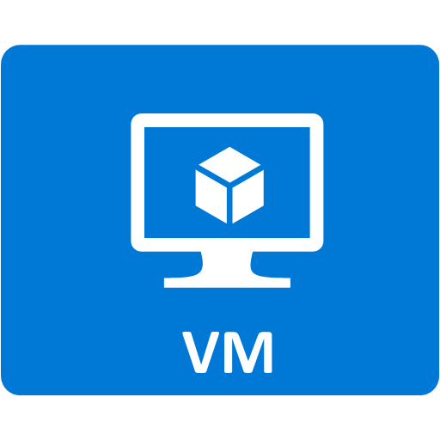
Azure VM Design Tips
Use certified VM types
Use Premium Storage for database
Consider backup and data retention
Set up HA + DR as needed
Guide customer to use ExpressRoute
1
2
3
4
5
Notes:
Here’re tips and key considerations / to design Azure VM / to run the most mission critical SAP / with extra large SAP database on Azure. / #1 (CLICK) – use certified Azure VM types,/especially for Production. / M Series VM will be certified / for both Any DB and HANA very soon, / and is good to use for Non-Production systems today. #2 (CLICK) – Use Premium Storage / instead of Standard / for database and all I/O intensive VMs. #3 (CLICK) – / don’t forget storage space / required to store backup. That said - / in addition to extra local storage space / to keep short-term backup, / make sure to add cool storage / or Azure Backup Vault / if long-term backup retention / is the requirement. #4 (CLICK) – set up high availability / and disaster recovery solutions. Note that database replication feature / such as SQL Server AlwaysOn /is more efficient and reliable / than Azure Site Recovery / for large database replication / to provide nearly zero RPO. Please also note that / our 3rd party solutions / such as / SIOS DataKeeper / is required today / to set up Windows failover cluster / for SAP ASCS on Azure. And #5 (CLICK) – ExpressRoute is always recommended for SAP environment. / This way / a customer in Australia for example / is running their entire SAP Business Suite / with 5TB ECC database / fully in Azure.
Use certified Azure VM types
Database (Any DB), Application : D/DS11 v2-D/DS15 v2 VM, GS1-GS5 VM
Certification for E_v3 and M are coming later this CY
Database (HANA) : GS5 VM
Certification for E_v3 and M are coming later this CY
Use Premium Storage to VMs running Database
Consider additional storage space to store backup
Short-term : local storage (same storage as SAP database files)
Long-term : Cool storage, Azure Backup Vault
Set up high availability and disaster recovery solutions as needed
Database HA/DR : SQL Server AlwaysOn, HANA System Replication, Oracle Data Guard etc
ASCS HA : Windows failover cluster with SIOS DataKeeper, Linux cluster
Certification for Windows 2016 failover cluster with SOFS (Scale Out File Server) coming later this CY
File DR : File replication tool
VM DR : Azure Site Recovery (Azure to Azure)
ExpressRoute is recommended for stable network latency, bandwidth & performance

Slide 32
Cost estimate assumptions
Included
Frontend ExpressRoute (customer – Azure VM) 500Mbps – Microsoft cost
3TB outbound (Azure VM -> outside)
SAP ASCS server VMs x 2 nodes x 2 (HA/DR)
E2s_v3, 2-core, 16GB of RAM, 2.1k SAPS / VM
Uptime SLA : 99.95%
SOFS VMs x 2 nodes x 2 (HA/DR)
E2s_v3, 2-core, 16GB of RAM
Uptime SLA : 99.95%
SAP database server VMs x 3 nodes
16-core, 128GB of RAM, 17k SAPS / VM
4TB SSD Storage / VM
Uptime SLA : 99.95%, AlwaysOn sync/async
3-year reserved instance discount
Standard-performance ExpressRoute Gateway x 2
Azure Backup Server VM x 2 with 5TB Storage
5-day data/log backup retention (short term)
Read Access Zone Redundant (RAGRS) Cool Storage : 35TB
750GB x (31 days + 12 months)
NOT Included
Frontend ExpressRoute (customer – Azure VM) 500Mbps – MPLS provider cost
Software licenses of SAP, SQL Server and Windows Server (use AHUB for Windows)
Microsoft Premier Support
Migration SI, Managed Services
Notes:
Some of the cost of the proposed solution is not included in the pricing estimate, primarily those resulting from the network connectivity infrastructure, licensing, and support requirements.

Slide 33
Preferred solution cost
Notes:
The estimated cost of the solution (as of 03/25/18) is $6,347.71 per month.

Slide 34
Azure VM Pricing Tips
Estimate VM uptime or check RI pricing if uptime is > 30%
Check sample BOMs to include Storage, Network, Management and Support
Use Windows Server as much as you can and apply AHUB to save OS costs
Make sure to propose multiple options to best meet customer requirements
Be clear with assumptions - OS/Software licenses, Support
Go live with Pay-As-You-Go and switch to RI once system utilization is clearer
1
2
3
4
5
6
Notes:
Tips to calculate costs of Azure / very accurately / so that you win every SAP opportunity by design - / #1 (CLICK) VM uptime is a critical input / for Compute Cost. #2 (CLICK) – think about using Compute Pre-purchase Plan – / or CPP / for VMs that need to be 24 x 7. CPP is a VM discount program / with 1-year pre-commit / which is available through Microsoft Enterprise Agreement / or EA. #3 (CLICK) –licensing of HANA Large Instances is / 1 or 3-year commitment, / there’s no pay-per-use – / and 3-year / s much more cost efficient / than 1-year. Note that ‘step-up’ SKUs are available / so that customer can start small / with a small SKU / let’s say 1.5TB / and switch to a larger SKU / say 4TB / even during the commitment period, / and paying only delta. #4 (CLICK) – make sure to include storage and network / in the bill of material. #5 (CLICK) – make sure to ask customer / to quote / SAP licenses, / linux os licenses / and Microsoft Support/ separately from our proposal. Note that / in case HANA Large Instances is used/ Microsoft Premier Support is required.
Estimate uptime of each Azure VM
Especially Non-Production systems
Use Compute Pre-purchase Plan (CPP) for Azure VM
VMs that are 24 x 7
Use 3-year commitment for HANA Large Instances
“Step-up” SKUs available to start small
Make sure to include costs for storage and VPN/ExpressRoute Gateway
Make sure to quote costs for SAP licenses, OS (RHEL/SLES) licenses and Microsoft Support
In case of HANA Large Instances Premier Support is required

Slide 35
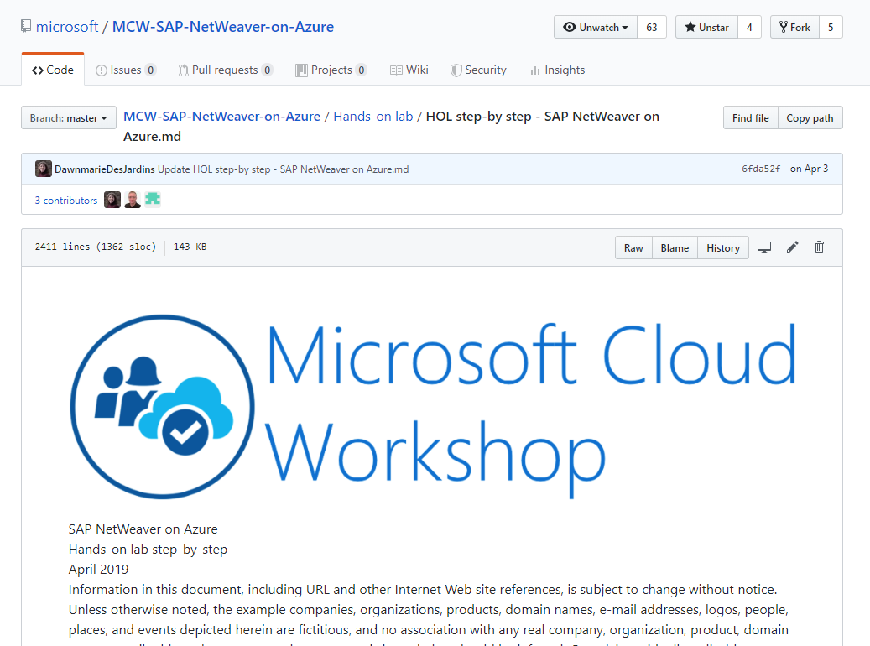
Deployment of SAP NetWeaver and SQL Server on Azure
Step-by-step Hands-on Lab guidance can be found here in Github

Slide 36
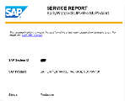
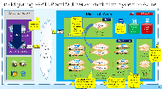
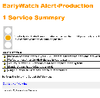
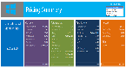
SAP on Azure - Cloud Assessment Session (= Architecture Design Session)
SAP on Microsoft Cloud
Cloud Assessment Session with Microsoft Global Black Belt Team
Inputs from customer
SAP Early Watch Report or HANA Sizing Report
or
Current hardware specifications (Server, storage, network)
Current software utilization (e.g. OS, DB, SAP, Non-SAP)
DB Metrics (e.g. DB volume)
Availability/security needs (Uptime, RPO/RTO, DR, Network)
Backup/Archival needs
Session Delivery (= 1 to 2 day)
Current SAP system analysis
Modernization scope & assumptions
Grand system design (e.g. Sizing, HA/DR/security, Performance, Automation)
Migration methodologies
Quote for Microsoft stack
Q&A
Deliverables
Written “To-Be” SAP architecture (Production, Non-Production)
ROI analysis
Planning of phased migration to minimize downtime and switching risks
Customer to share information on their current SAP/LOB systems
with Microsoft PEAT
Microsoft and Customer to discover how Microsoft Cloud and Technologies can best help modernize customer’s SAP/LOB systems
Customer to start to engage with their SI partner(s) to execute cloud modernization
Notes:
Step through the process of carrying out a cloud assessment session

Slide 37




Go Dos and Resources
Learn
SAP on Azure Website
SAP on MS Platform blog
SAP on Azure – SAP Community Wiki
SAP HANA/NetWeaver on Azure Documentation
HANA on Azure Large Instances Architecture
SAP on Azure reference architecture
Microsoft Partner Network – SAP on Azure
Whiteboard Design Session and Hands-on Lab (HANA and Any DB)
How Microsoft IT runs SAP
SAP on Azure case study videos
SAP HANA Academy
Open SAP
SAP on Azure Infopedia Product Hub (Internal)
SAP on Azure roadmap (Internal/NDA)
Battlecards (Internal)
SAP on Azure Tech Community Call (Internal)
Touch
SAP Cloud Appliance Library
SAP HANA on Azure SUSE Linux templates
SAP HANA on Azure ARM templates
Ask
SAP on Azure Yammer (Internal)
Contact SAP Technical Community saptalk@microsoft.com
Engage
Contact : Americas SAP on Azure CoE SAPGBBAMERICAS@microsoft.com, EMEA SAP on Azure CoE SAPGBBEMEA@microsoft.com or Asia SAP on Azure CoE SAPGBBASIA@microsoft.com
Notes:
Verify that the resources referenced on this slide are up-to-date

Slide 38
Latest SAP NetWeaver on Azure content can be found at : https://github.com/microsoft/MCW-SAP-NetWeaver-on-Azure/tree/master/Whiteboard%20design%20session

Slide 39
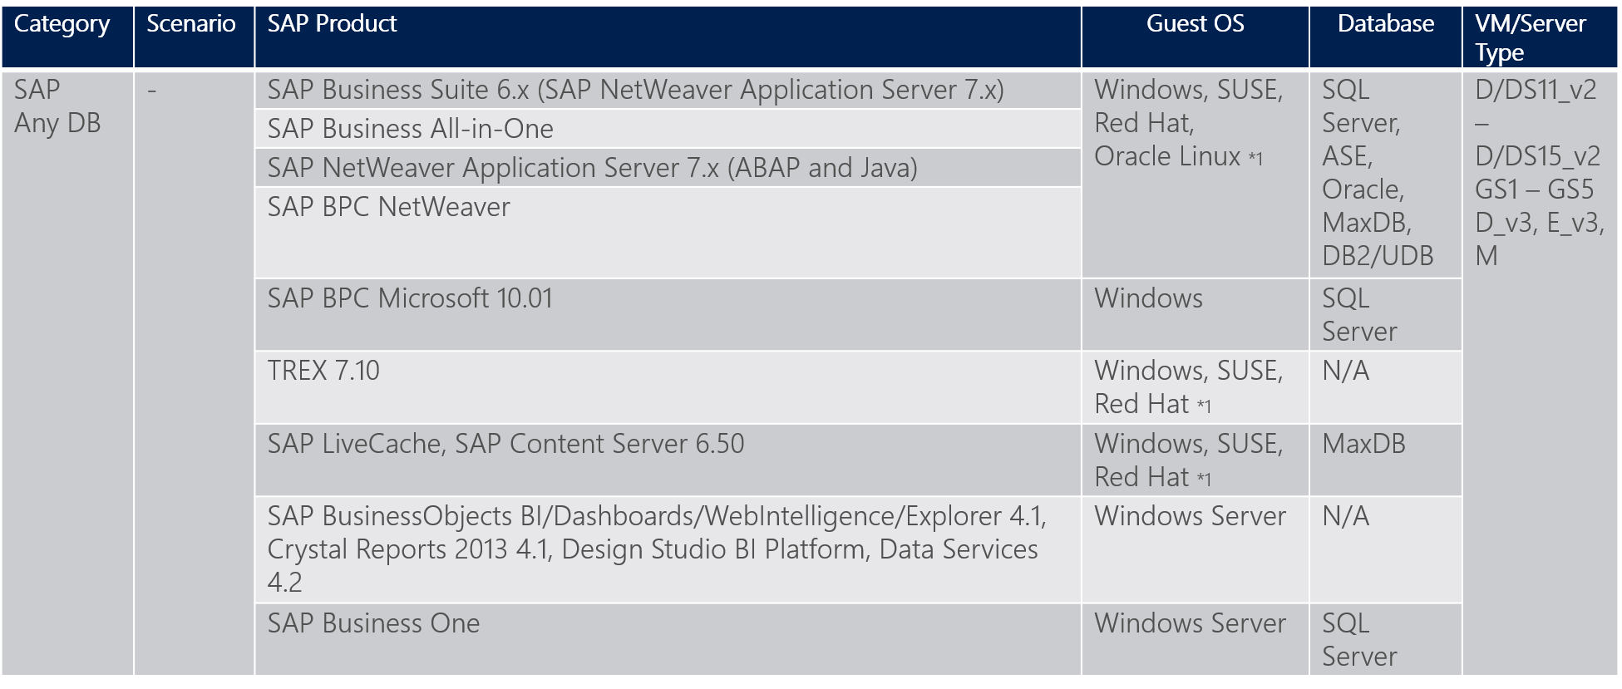
SAP on Azure certifications (Any DB)
(*1) SUSE and Red Hat are certified only with ASE, DB2 and HANA. Oracle Linux is for Oracle. Windows Server is for all databases.
Notes:
You must ensure that the combination of the server OS and the database management platform is supported by SAP.

Slide 40
S/4HANA HA in Availability Set and DR across Regions (DR Failover)
Primary Azure Region
Secondary Azure Region
AvSet
AvSet
HANA Database layer (=SPOF)
HSR Sync on Linux Pacemaker Cluster
HSR Replication
AvSet
Blob storage for ASR
AvSet
SAP Central Services (ASCS) layer on Windows (=SPOF)
ASR Failover
ASCS on Windows Failover Cluster
ASCS on Windows Failover Cluster
AvSet
AvSet
SAP file share layer on Windows (=SPOF)
SOFS on Windows Failover Cluster
ASR Failover
SOFS on Windows Failover Cluster
AvSet
AvSet
SAP Application Server layer (= Non-SPOF)
SAP Logon Group
ASR Failover
SAP Logon Group

Slide 41
S/4HANA HA and DR across Availability Zones (DR Failover)
Azure Availability Zone 1 (Active)
Azure Availability Zone 2
HANA Database layer (=SPOF)
HSR Failover
SAP Central Services (ASCS) layer on Windows (=SPOF)
ASCS Failover
SAP file share layer on Windows (=SPOF)
SOFS Failover
SAP Application Server layer (= Non-SPOF)
SAP Logon Group
SAP Logon Group

Slide 42
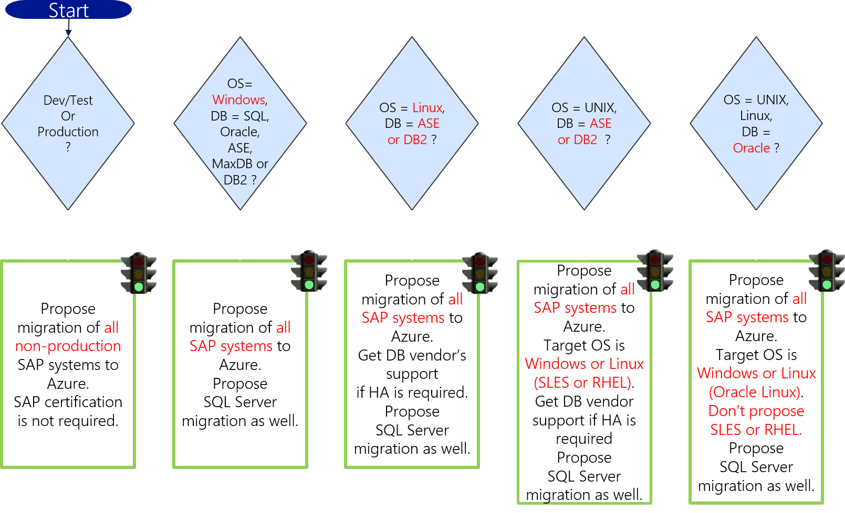
Qualifying SAP on Azure Opportunities (Any DB)
Notes:
When choosing the OS/DBMS platform, follow the workflow provided on this slide.

Slide 43
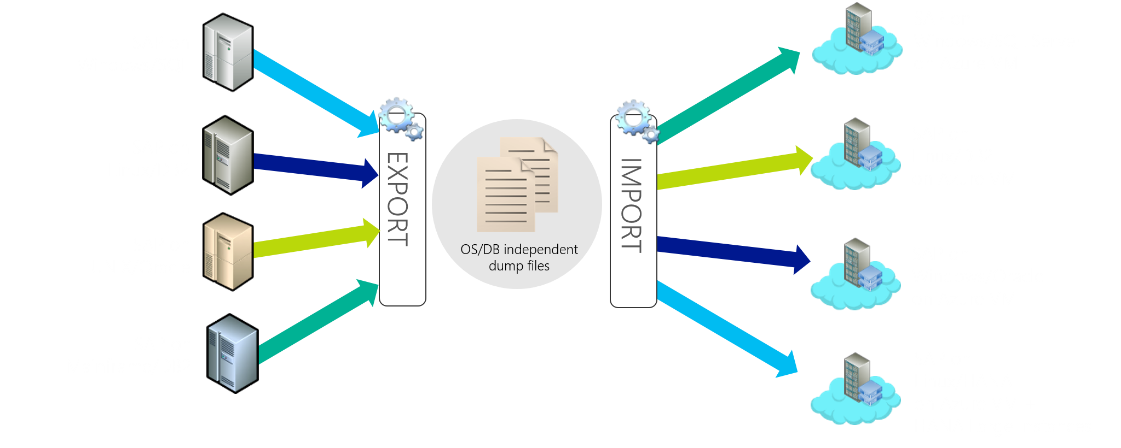
Modernizing SAP platform on Microsoft Cloud OS
Notes:
As part of the migration, you have the option of modernizing your SAP platform.

Slide 44
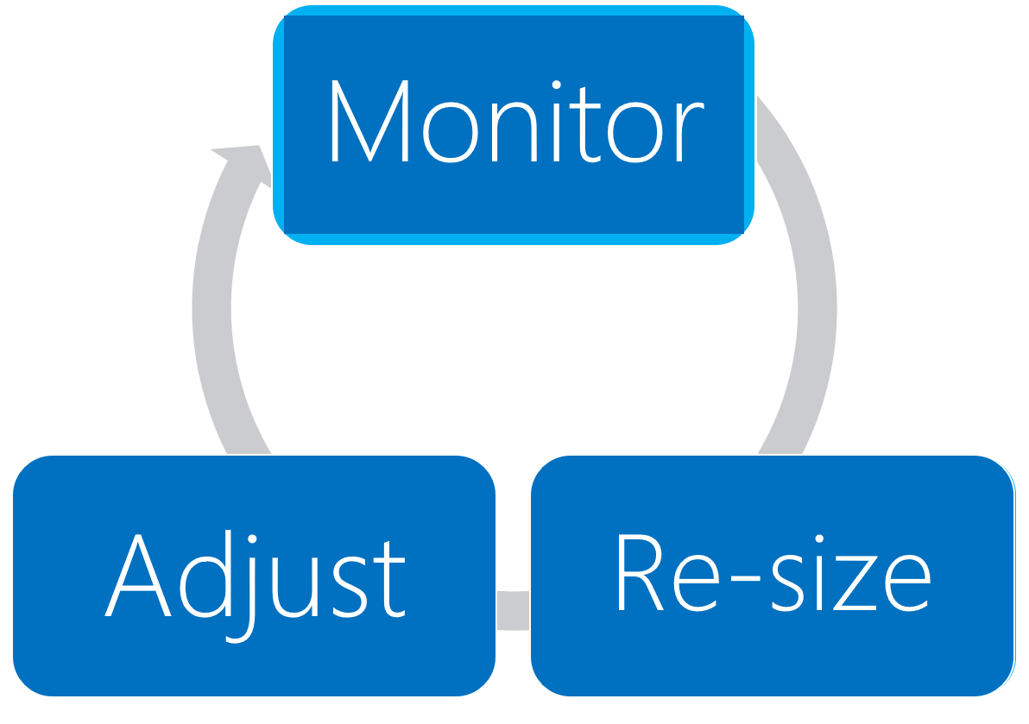
Process to optimize SAP landscape
Notes:
The solution sizing is a continuous process that involve monitoring, re-sizing, and adjusting. Fortunately, resizing Azure VMs is a straightforward process.

